Slide 1

Refactor Java with Confidence Workshop
Steven Diamante August 13, 2025

Slide 2
Play
Add Tests
Refactor

Slide 3

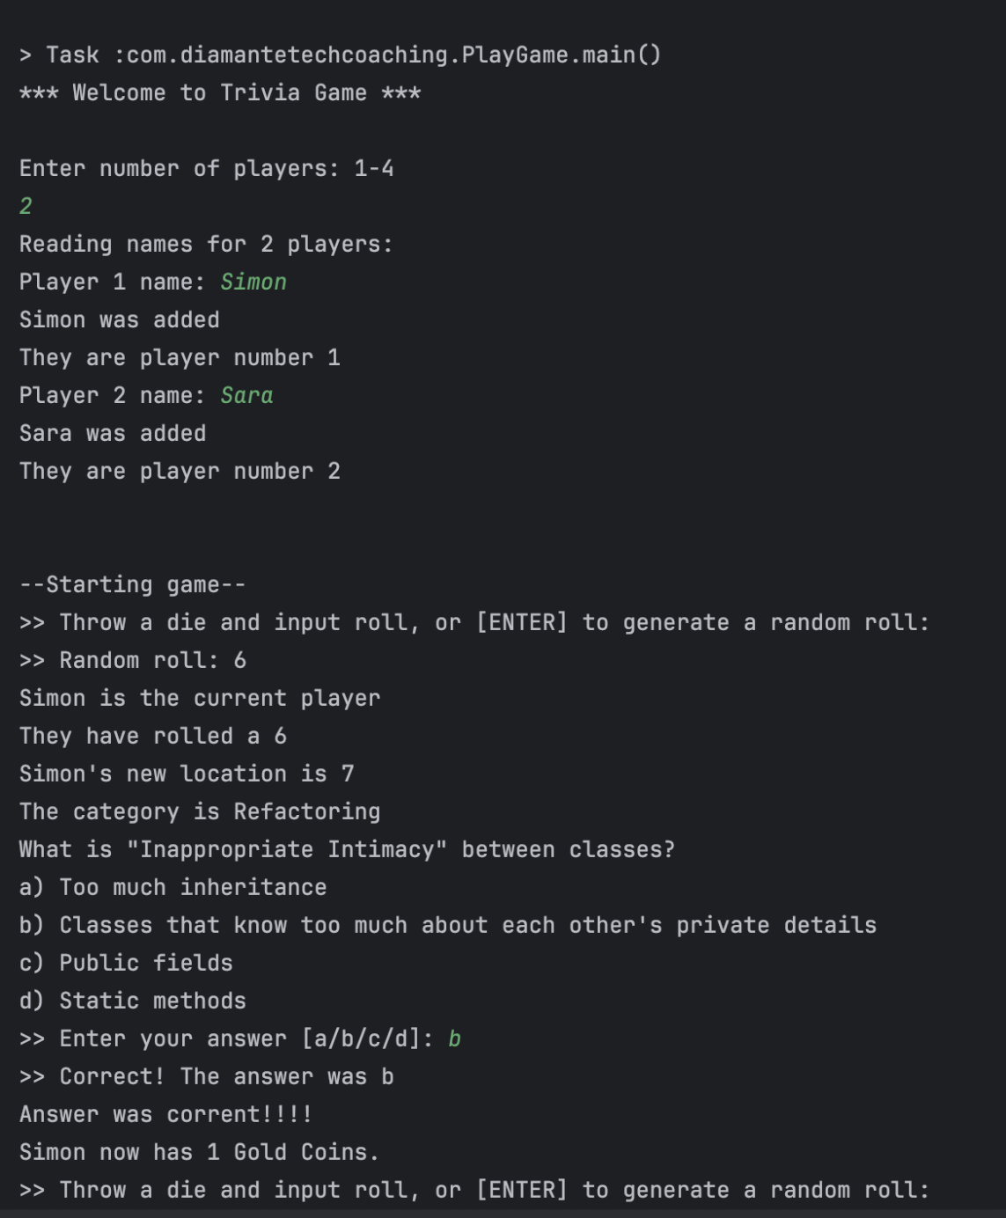

Refactoring
Software History
Play
Testing
Programming Languages

Slide 4
What is Refactoring?
Improving code design by changing the internal structure of existing code without changing its external behavior
Notes:
a change made to the internal structure of software to make it easier to understand and cheaper to modify without changing its observable behavior

Slide 5
Refactoring Misconceptions
True or False
① Refactoring work should be planned and prioritized alongside user stories for the sprint.
True
False

Slide 6
Refactoring Misconceptions
True or False
② When someone is refactoring the code may be broken for a few days while they do it.
True
False

Slide 7
Refactoring Misconceptions
True or False
③ If you encounter ugly code it is your moral duty to refactor it.
True
False

Slide 8
Refactoring Misconceptions
True or False
④ If you see duplication in the code you should use refactoring to remove it.
True
False

Slide 9
Refactoring Misconceptions
True or False
⑤ If you see duplication in the code you should use refactoring to remove it.
True
False

Slide 10
Refactoring Misconceptions
True or False
⑥ If you don’t understand the code you shouldn’t refactor it.
True
False

Slide 11
Refactoring Misconceptions
True or False
⑦ When we invest time in refactoring it saves us time overall.
True
False

Slide 12
Refactoring Misconceptions
True or False
⑧ A good time to refactor is before you add a new feature to make adding it easier.
True
False

Slide 13
Refactoring Misconceptions
True or False
⑨ Refactoring is a way of paying off technical debt.
True
False

Slide 14
Refactoring Misconceptions
True or False
①⓪ You can only refactor if you have test coverage over 80%.
True
False

Slide 15
Why is Refactoring important?
Sustainable pace
Code becomes easier to read and modify
Evolutionary design
Easier testing and debugging

Slide 16
Play
Add Tests
Refactor

Slide 17
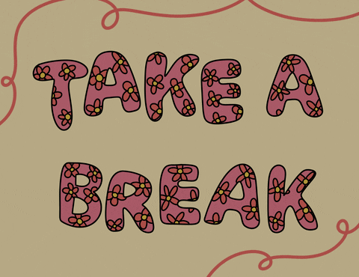

Slide 18

Add Tests
Notes:
Explain why a solid automated test suite is necessary

Slide 19
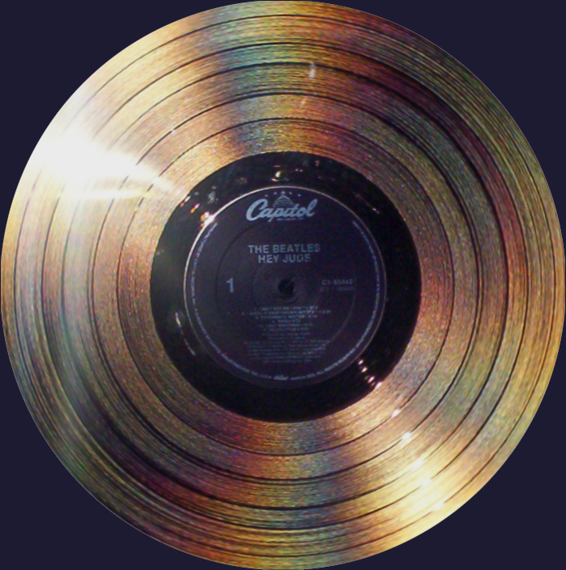
Approval Testing
= Golden Master
= Characterization
Tests
= Snapshot Tests

Slide 20


Notes:
Demo how to break dependencies and add Approvals
Spend 15 mins solo
Practicing in the same way demonstrated

Slide 21


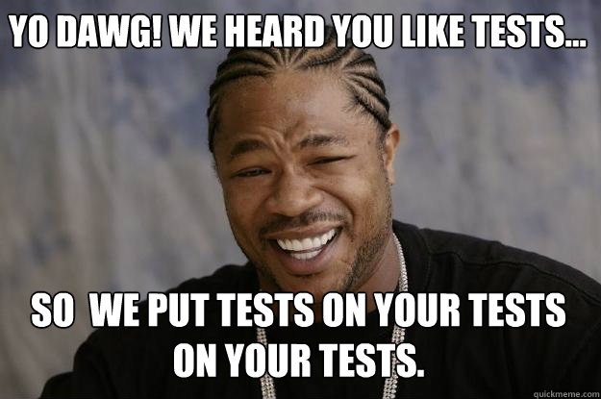
Mutation Tests

Slide 22
Play
Add Tests
Refactor

Slide 23
Refactor

Slide 24
What’s not to like about this code?
Find a buddy
Review the Game class
Share things you don’t like about the code
Take notes in the code or elsewhere
Notes:
Find a Buddy
Split into pairs
Review the Game class and share things you don’t like about the code. Be honest. Try to explain why you don’t like something.
Make a note of it

Slide 25
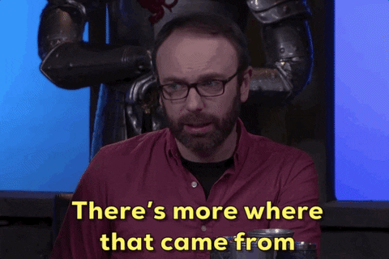
Code smells
Long method
Nested Conditionals
Mixed Concerns
Primitive Obsession
Data Clumps
Feature Envy

Slide 26


Know your tools

Slide 27
Refactoring | Windows/Linux | Mac | What It Does
Rename | Shift + F6 | Shift + F6 | Rename variables, methods, classes safely
Inline | Ctrl + Alt + N | Cmd + Alt + N | Remove unnecessary variables/methods
Extract Method | Ctrl + Alt + M | Cmd + Alt + M | Pull code into a new method
Introduce Local Variable | Ctrl + Alt + V | Cmd + Alt + V | Create variable from expression
Introduce Parameter | Ctrl + Alt + P | Cmd + Alt + P | Turn local variable into parameter
Introduce Field | Ctrl + Alt + F | Cmd + Alt + F | Turn local variable into class field
Notes:
https://arlobelshee.com/the-core-6-refactorings/

Slide 28
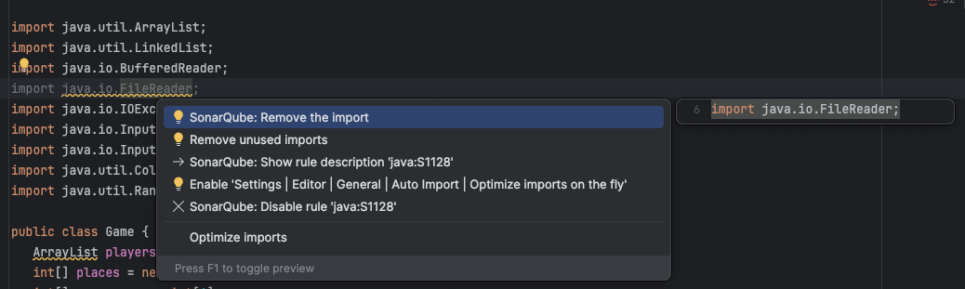
IntelliJ Essentials
Show Context Actions —
Alt + Enter (Windows) | Option + Enter (Mac)

Slide 29
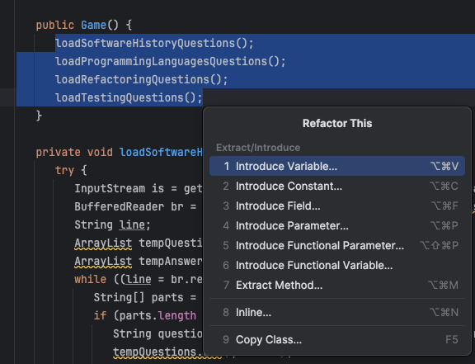
IntelliJ Essentials
Refactor This —
Shift+Ctrl+Alt+T (Windows) Ctrl + T (Mac)

Slide 30
Good Refactoring Habits
Breakdown large refactorings into a series of small steps
Run the tests after each small refactoring step
Focus on one thing at a time
Use automated refactorings whenever possible

Slide 31
Remove Clutter
Dead code
Unhelpful comments
Linter warnings
This gives you a chance to scan the code and start spotting areas of improvement
Notes:
Sparrow Decks? Remove Clutter https://learnwithllew.github.io/SparrowDecks/#/ Starting from the top of the file. Look for any of the following.

Slide 32
Removing Duplication
Removing Duplication
Removing Duplication
Notice the slight differences between two code paragraphs
Make the paragraphs look identical
Extract a method
Clean up any temporary variables and braces
Notes:
https://learnwithllew.github.io/SparrowDecks/#/

Slide 33
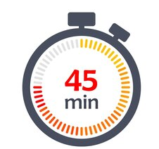
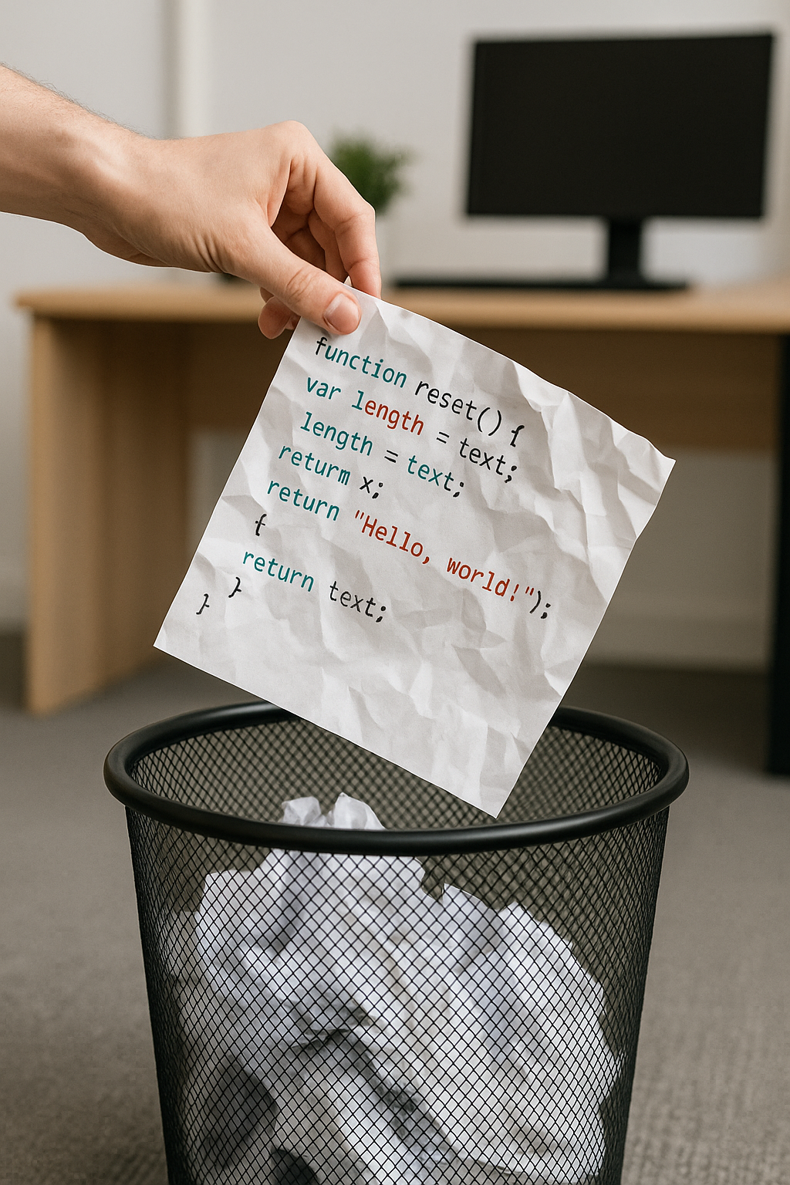
Scratch refactor with your pair
Review your list of what bothered you about the code
Pick an item off the list and refactor with your pair
After completing an item, switch roles
Commit often

Slide 34
Data Clumps
— occurs when you have groups of data items that repeatedly appear together in multiple places throughout your code. Instead of being logically organized into a single cohesive structure
Long methods are good places for classes to hide
What classes could be hiding here?
Spot any data clumps?

Slide 35
Parallel Change
— Add the new thing
— Migrate callers to use the new thing
— Remove the old thing
Manual refactoring done safely
Similar to API versioning
Tests are passing the entire time

Slide 36
Feature Envy
— code that uses another class's data/methods more than its own - it probably belongs in that other class instead
Follow the getters
Extract and move method
Tell, don’t ask

Slide 37
Play
Add Tests
Refactor

Slide 38
Retro
What did you learn?
What's one refactoring habit you'll start doing regularly?
What is still puzzling you?

Slide 39
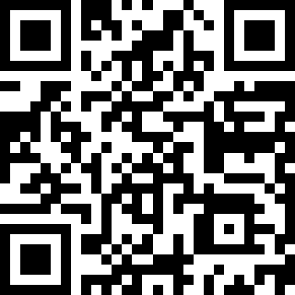
Resources
https://tinyurl.com/refactoring-kcdc

